Slide 1
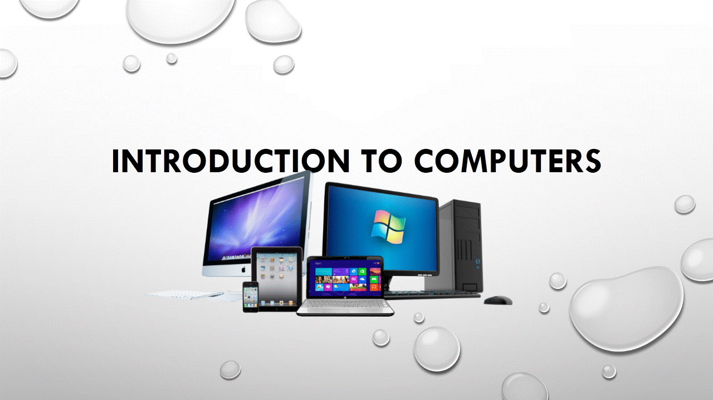
Use cases, user stories, notes to set up the wireframes. Such as…
“As an Administrator, I would like to restrict permissions based on role.”
“As a Moderator, I would like to flag and approve comments.”
Executives indicated that being able to see a summary of each segment of data was their #1 priority.
Note: secondary admin workflow not planned for this release.

Slide 2
Outline
Definition of computer
Historical overview of the computer.
Generations of computers
The concept of data and information
Basic understanding of data processing
Characteristics of a computer

Slide 3
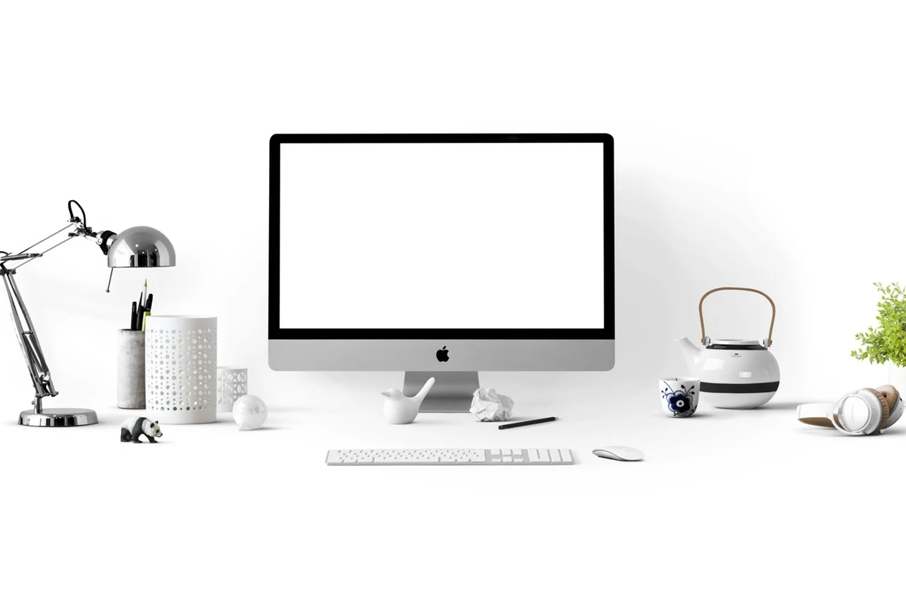
Definition of computer
A computer is an electronic device that processes data and performs tasks according to a set of instructions called a program. It can store, retrieve, and process data, making it a versatile tool for various applications.
A computer is capable of taking input data, storing the data processing them, and eventually giving an output.

Slide 4
History of the computer
The historical journey of computers involves numerous innovations. Here's a brief historical overview of key developments in the evolution of computers:
Abacus (2000 BCE): Often considered the earliest computing device, the abacus was used for basic arithmetic calculations. It consisted of beads or pebbles manipulated on rods or wires.
Mechanical Calculators (17th Century): Inventors like Blaise Pascal and Gottfried Wilhelm Leibniz created mechanical devices for performing arithmetic calculations. Pascal's Pascaline and Leibniz's Step Reckoner are notable examples.
Analytical Engine Concept (1837): Charles Babbage conceived the idea of a general-purpose mechanical computer known as the Analytical Engine. Although it was never fully built during his lifetime, Babbage is recognized as the "father of the computer."

Slide 5
History of the computer cont.
Transistors (1950s): The invention of transistors replaced vacuum tubes in computers, leading to smaller, more reliable, and energy-efficient devices. This marked the beginning of the second generation of computers.
Integrated Circuits (1960s): Jack Kilby and Robert Noyce independently invented the integrated circuit, which allowed multiple electronic components to be integrated onto a single chip. This innovation led to the development of smaller and more powerful computers.
Microprocessors (1970s): The invention of the microprocessor, a complete central processing unit on a single chip, by companies like Intel and Motorola, revolutionized computing and made personal computers practical and affordable.

Slide 6
History of the computer cont.
Personal Computers (1980s-1990s): Companies like IBM, Apple, and Microsoft played key roles in popularizing personal computers. Graphical user interfaces (GUIs) and the rise of the internet further transformed computing during this era.
Mobile Computing (2000s-Present): The proliferation of smartphones and tablets brought computing power to the hands of millions. Advances in mobile technology, cloud computing, and the Internet of Things (IoT) continue to shape the modern computing landscape.

Slide 7
Generation of Computer
Computers have evolved through distinct generations, each marked by significant advancements in technology.
These generations are commonly categorized as follows:
First Generation (1940s-1950s):
Technology: Vacuum tubes were used for electronic components.
Characteristics: Large, expensive, and unreliable. Programmed using machine language.
Examples: ENIAC, UNIVAC I.
Second Generation (1950s-1960s):
Technology: Transistors replaced vacuum tubes, reducing size and improving reliability.
Characteristics: Smaller, faster, and more reliable. Assembly languages and early high-level languages were introduced.
Examples: IBM 1401, IBM 7094.

Slide 8
Generation of Computer cont.
Third Generation (1960s-1970s):
Technology: Integrated circuits (ICs) brought multiple transistors onto a single chip.
Characteristics: Smaller, more powerful, and energy-efficient. The use of high-level programming languages increased.
Examples: IBM System/360, DEC PDP-11.
Fourth Generation (1970s-1980s):
Technology: Microprocessors, combine the entire CPU on a single chip.
Characteristics: Personal computers have become practical and affordable. Introduction of graphical user interfaces (GUIs) and networking.
Examples: IBM PC, Apple Macintosh

Slide 9
Generation of Computer cont.
Fifth Generation (1990s-Present):
Technology: Advances in parallel processing, artificial intelligence, and supercomputing.
Characteristics: Focus on parallel computing, AI, and natural language processing. Integration of multiple technologies.
Examples: Modern desktops, laptops, servers, and supercomputers.
The concept of generations helps capture the major technological shifts in the development of computers over time

Slide 10
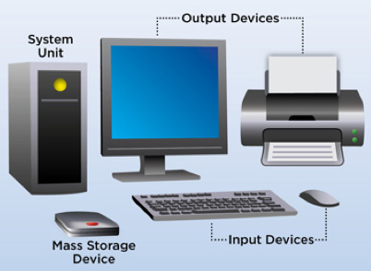
A computer system
A computing system is an integrated device that involves input, output, processing, and storage of data and information. It can be a programmable electronic device that accepts input, stores data, and retrieves, processes, and outputs information. Computing systems can range from simple sensors and hardware components to phones, laptops, desktops, and entire data centers.
They are used in various fields and applications, such as personal computing, business, and scientific research.

Slide 11
Components of computer system
Key components of a computing system
Hardware: These are the physical components, such as processors, memory, and storage devices, that make up the system.
Software: The main software component is the operating system (OS), which manages and provides services to the hardware and software components. Other software components may include applications, drivers, and utilities that help the system function efficiently.
Networking: Computing systems can be connected to other devices or systems through networks, enabling communication and data sharing.
Computer Users: Computer users are the different categories of personnel that operate the computer. There are expert users and casual users. The expert users could be further categorized into computer engineers, computer programmers, and computer operators.

Slide 12
Characteristics of a computer
Computers possess several key characteristics that define their functionality and utility.
Speed: The computer can manipulate large data at incredible speed and response time can be very fast.
Accuracy: Its accuracy is very high and its consistency can be relied upon. Errors committed in computing are mostly due to human rather than technological weakness. There are in-built error-detecting schemes in the computer.
Storage: It has both internal and external storage facilities for holding data and instructions. This capacity varies from one machine to the other. Memories are built up in K(Kilo) modules where K = 1024 memory locations.

Slide 13
Characteristics of a computer cont.
Automatic: Once a program is in the computer’s memory, it can run automatically each time it is opened. The individual has little or no instruction to give again.
Reliability: Being a machine, a computer does not suffer human traits of tiredness and lack of concentration. It will perform the last job with the same speed and accuracy as the first job every time even if ten million jobs are involved.
Flexibility: It can perform any type of task once it can be reduced to logical steps. Modern computers can be used to perform a variety of functions like online processing, multi-programming, real-time processing, etc.

Slide 14
Data and Information
Data refers to raw and unprocessed facts.
Data is often described as a collection of individual facts or statistics, and it can be represented in various forms such as text, images, and structured or unstructured data.
Information comprises processed, organized data presented in a meaningful context.
Information is the result of analyzing and interpreting pieces of data, providing a big-picture view of how the data fits together and enabling decision-making.

Slide 15
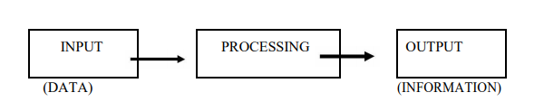
Data Processing
Data processing is the manipulation and organization of data to produce meaningful information. It involves various operations that transform raw data into a more understandable and useful form.

Slide 16
Data Processing Cycle
Input:
Collection of raw data from various sources.
Examples: keyboard input, sensors, databases, etc.
Processing:
Manipulation and transformation of raw data into a more meaningful form.
Involves calculations, sorting, filtering, and other operations.
Output:
Presentation of processed data in a human-readable format.
Examples: reports, graphs, visualizations.
Storage:
Archiving processed data for future reference or analysis.
Stored in databases, file systems, or other storage devices

Slide 17
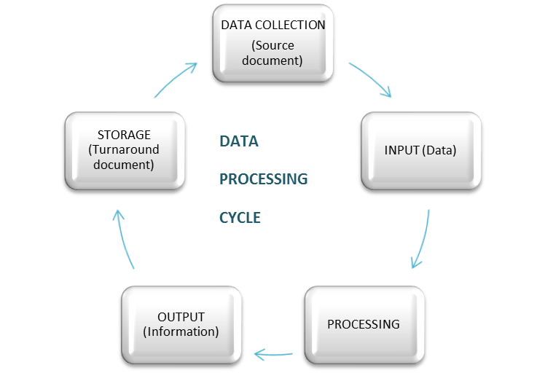
Data Processing Cycle

Slide 18
Components Data Processing
Central Processing Unit (CPU):
The "brain" of the computer that executes instructions.
Performs arithmetic and logical operations.
Memory (RAM):
Temporary storage for data and programs in use.
Faster access than long-term storage.
Storage Devices:
Long-term storage for data, programs, and operating systems.
Examples: hard drives, solid-state drives (SSD), cloud storage.
Software:
Programs that instruct the computer on how to process and manipulate data.
Includes operating systems, applications, and utilities.

Slide 19
Data and Information
Data | Information
Raw, unorganized, and unprocessed facts | Processed, organized, and structured data presented in a meaningful context
Individual units that contain raw materials that do not carry any specific meaning | A group of data that collectively carries a logical meaning
Does not depend on information | Dependent on data
Measured in terms of bits and bytes | Measured in meaningful units like time, quantity, etc.
Variables that help to develop ideas/conclusions | Meaningful data
Text and numerical values | Refined form of actual data

Slide 20
QUESTIONS?

Slide 21
THANK YOU!

